Slide 1
SILICON CONTROLLED RECTIFIER

Slide 2
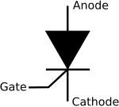
SCR.
Type | Active
Inventor | Gordon Hall and Frank W. "Bill”
First production | General Electric, 1957
Pin names | Anode, gate and cathode
Electronic symbol
CIT. 2nd Year CIT-244

Slide 3
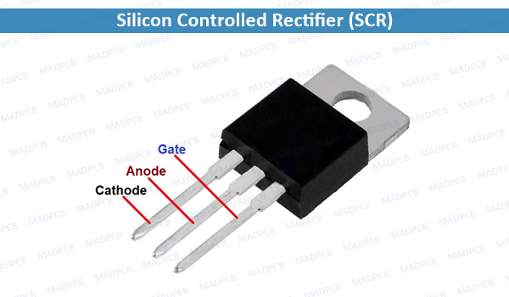
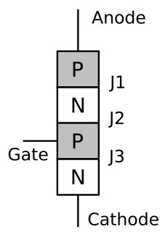
CIT. 2nd Year CIT-244

Slide 4
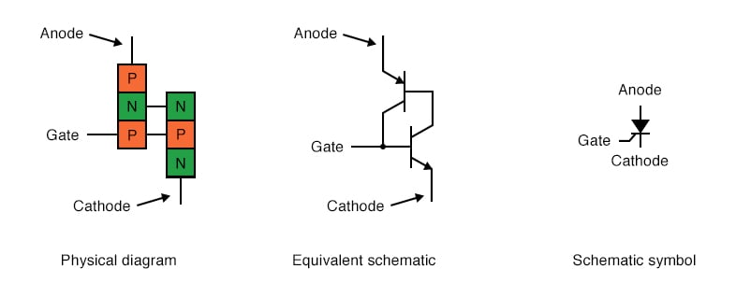
Silicon-Controlled Rectifier (SCR)
CIT. 2nd Year CIT-244

Slide 5
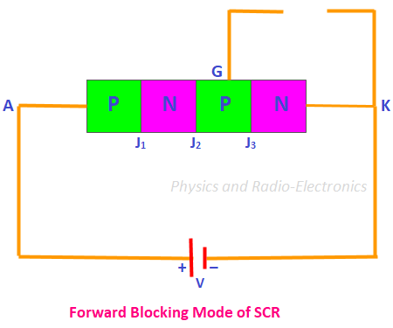
Modes of Operation in SCR
1) Forward Blocking Mode (Off State)
2) Forward Conducting Mode (On State)
3) Reverse Blocking Mode (Off State)
CIT. 2nd Year CIT-244

Slide 6
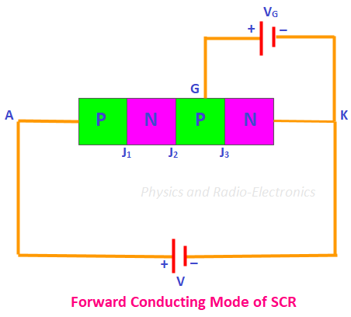
CIT. 2nd Year CIT-244

Slide 7
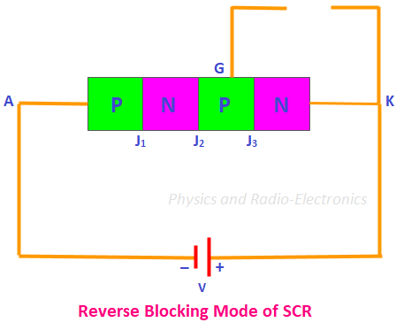
CIT. 2nd Year CIT-244

Slide 8
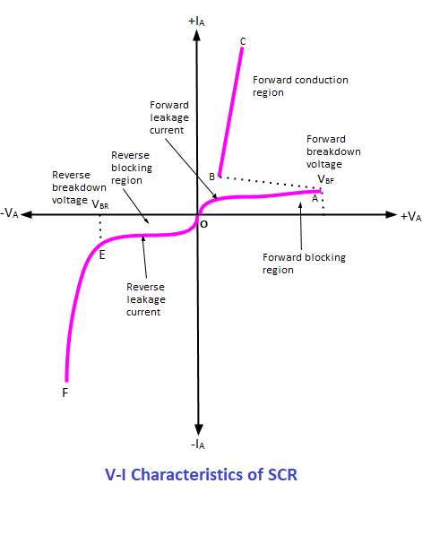
CIT. 2nd Year CIT-244

Slide 9
APPLICATION.
SCRs are mainly used in devices where the control of high power, possibly at high voltage.
The ability to switch large currents on and off makes the SCR.
Suitable for use in medium to high-voltage.
AC power control .
Lamp dimming.
Regulators.
Motor control.
CIT. 2nd Year CIT-244

